Slide 1
ENTERPRISE APPLICATION DEVELOPMENT

Slide 2
Unit-I, Module-I Web Fundamentals

Slide 3
ENTERPRISE APPLICATION DEVELOPMENT
Full Stack Development:
It refers to the development of both front end(client side) and back end(server side) portions of web application.
The front end consists of the user interface (or UI), and the back end handles the business logic and application workflows that run behind the scenes.
Full stack developers possess the skills and knowledge to work across the entire technology stack, enabling seamless user experiences and developing robust backends.
Full Stack Web Developers:
A full stack developer is one who is comfortable working with both backend and frontend technologies.
Full Stack web developers have the ability to design complete web applications and websites.
They work on the frontend, backend, database, and debugging of web applications or websites.

Slide 4
Technology Related to Full Stack Development
Front-end Development:
It is the visible part of website or web application which is responsible for user experience. The user directly interacts with the front end portion of the web application or website.
Front-end Technologies:
HTML
CSS
JavaScript
Front End Libraries and Frameworks
AngularJS
React.js
Bootstrap
jQuery

Slide 5
Technology Related to Full Stack Development
Back-end Technologies
PHP
C++
Java
Python
Node.js
Back End Frameworks (Express, Django, Rails, Laravel, Spring etc)
Database
Oracle
MongoDB
SQL

Slide 6
Syllabus
UNIT-I
Introduction to full stack: MVC pattern, Web Fundamentals. HTML 5.0: Basic tags, HTML DOM, Images, Tables, Lists, Forms, Layout, Graphics, span and div tags.
Introduction to Cascading Style Sheets: Types of CSS, CSS Selectors, CSS BOX Model, Text and Font, Color, CSS Positioning and CSS floating, CSS Grid layout Module, CSS Media Queries.
UNIT-II
Java Script: Data Types & Type Conversion, JSON, Events, String and Date Functions, Local Storage, Object Oriented Programming (OOP) in JS, JavaScript Regular Expressions.
Bootstrap: Introduction of Bootstrap, Container and Container-fluid, Bootstrap Carousel.
Bootstrap Component: Button, Grid, Table, Form, Alert, Image, Tabs/Pill, Navbar, Modals.

Slide 7
Cont..
UNIT-III
React JS: Introduction to React, React with JSX, Actual DOM vs React VDOM, Components, Lifecycle, State, Props, Fragments, Events, Router, Forms, Pagination, Tables, Portals, Hook, Signals. React 18 New features.
Redux and MUI: Introduction to Redux, State, Actions, Reducers, Color Reducer, Sort Reducer, Store, Action Creators, Middleware. React Material UI Introduction and Installation, MUI Input Components.
Integration of Google MAP API and GPS Location Tracking: Incorporating Google MAP API and GPS Location Tracking for location-based services.

Slide 8
Cont..
UNIT-IV
Node JS: Modules, Node Package Manager(npm), Creating Web Server, Sending Requests and Handling HTTP requests, Handling User authentication with NodeJS, File System, Writing a file asynchronously and Other I/O Operations.
Events: Event Emitter class, Inheriting Events and Returning event emitter.
Express JS: Introduction to the Express framework- Server-side rendering with Templating Engines, Routing, Middleware, Custom Middleware, static files.
UNIT-V
Mongo DB: Introduction, Importance of NoSQL databases, JSON Vs BSON, Data types and examples. CRUD Operations, Data Modelling & Schema Design, Indexing and Aggregation, MongoDB Replication and Sharding.

Slide 9
Cont..
Text Books:
Vasan Subramanian, "Pro MERN Stack: Full Stack Web App Development with Mongo, Express, React, and Node", Second Edition, Apress Publications, 2019.
David Hows, Peter Membrey, EelcoPlugge – “MongoDB Basics”, Apress, 2014.
Suggested Reading:
Ethan Brown, “Web Development with Node and Express”, Oreilly Publishers, First Edition, 2014.
Web Resources:
https://web.stanford.edu/class/cs142/index.html
https://nodejs.org/en/docs/
https://www.mongodb.com/
https://reactjs.org/
https://getbootstrap.com/docs/5.0/utilities/api/
https://edu.anarcho-copy.org/Programming%20Languages/Node/

Slide 10
Course Objectives:
This course aims to:
Provide knowledge about web pages design and development.
Understand how the HTML, CSS and JavaScript components of Bootstrap work.
Explore the basic architecture of a React application and develop applications in agile mode.
Gain the basics of frond-end and back-end application development using Nodejs.
Understand the basics of MongoDB and its Data Model.

Slide 11
Course Outcomes:
Upon successful completion of this course, students will be able to:
Create web pages with good aesthetic sense of design using HTML and CSS.
Create real-world React web applications and related tools.
Become an agile practitioner with the ability to quickly complete projects.
Build an end-to-end application from scratch using NODE JS.
Understand and build logical relationships between documents using MongoDB.

Slide 12


POPULAR TECH STACKS
MERN STACK
MEAN STACK
MongoDB
ExpressJS
ReactJS
NodeJS
MongoDB
ExpressJS
AngularJS
NodeJS

Slide 13

Cont..
MEVN STACK

Slide 14
Difference between MEAN and MERN
The front-end framework is the primary difference between MEAN and MERN technology.
MEAN stack uses Angular, while the MERN stack uses React.
Additionally, the MEAN stack uses MongoDB as its database, while the MERN stack uses MongoDB or any other NoSQL database. Both stacks use Node.js as the back-end framework.
Mongo DB : Its a database which is using BSON format to store data.
Express JS : Its a framework of JavaScript which enables developer to establish server.
React JS : React JS is client side library of JavaScript which is used to develop User Interface.
Node JS :Node JS is a run time environment of JavaScript which allows developer to execute JS code directly in console
Angular : Angular is client side framework which is used to develop User Interface.

Slide 15
Stages in Full Stack Developer
Stage 1: HTML
Stage 2: CSS
Stage 3: JavaScript
Stage 4: ReactJs
Stage 5: NodeJs
Stage 6: ExpressJS
Stage 7: MongoDB

Slide 16
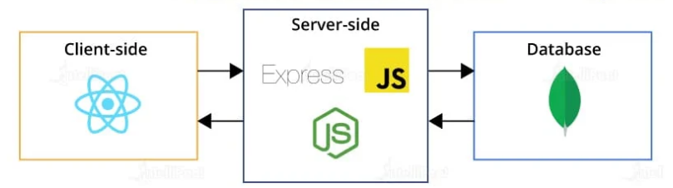
3- Tier Architecture of MERN Stack

Slide 17
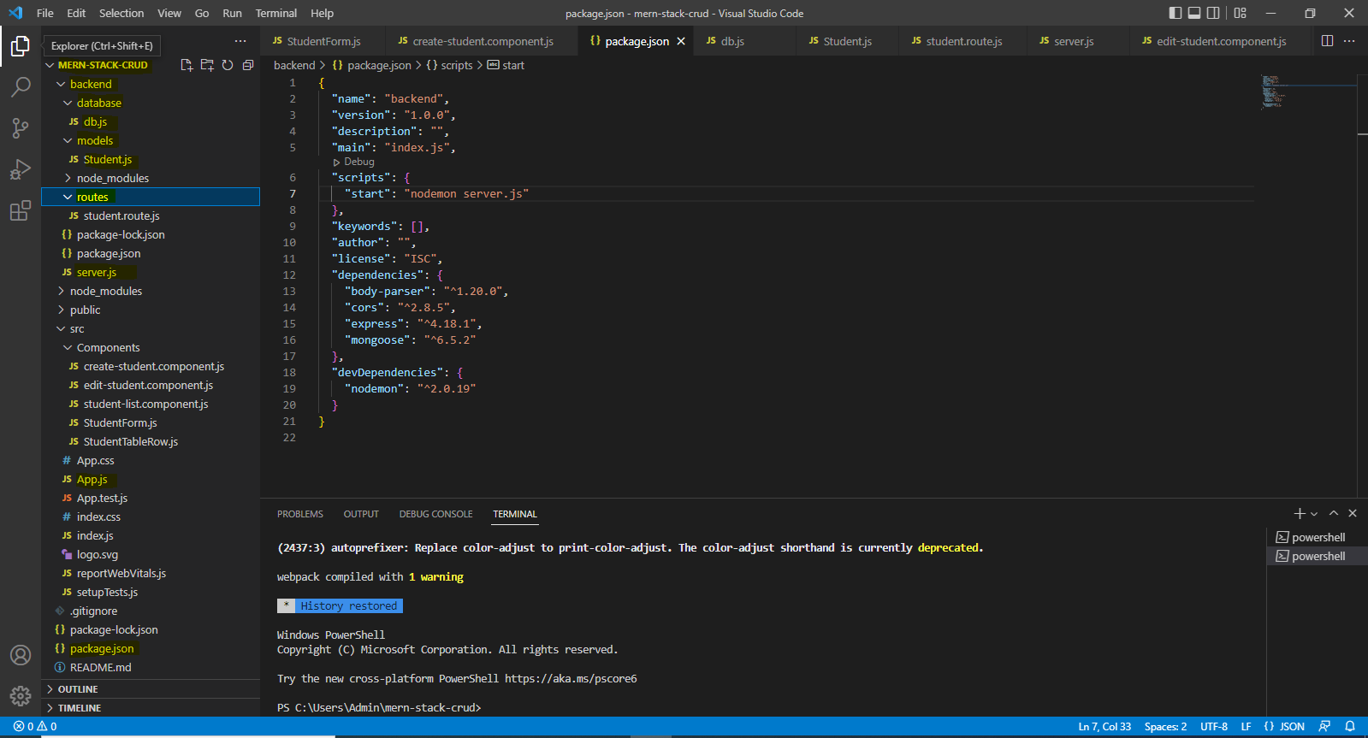
IDE’S Required for FSD-VS Code

Slide 18
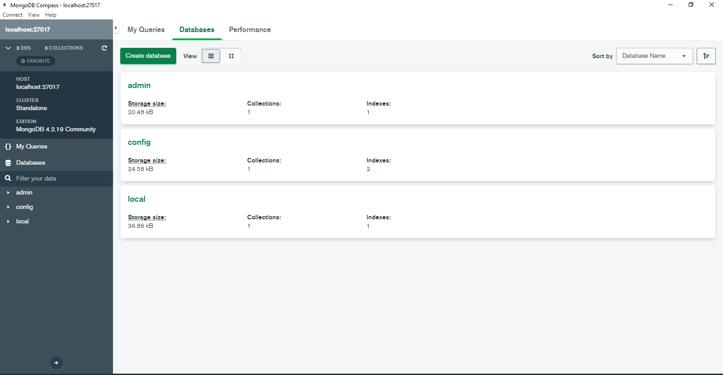
IDE’S Required for FSD-MongoDB Compass

Slide 19
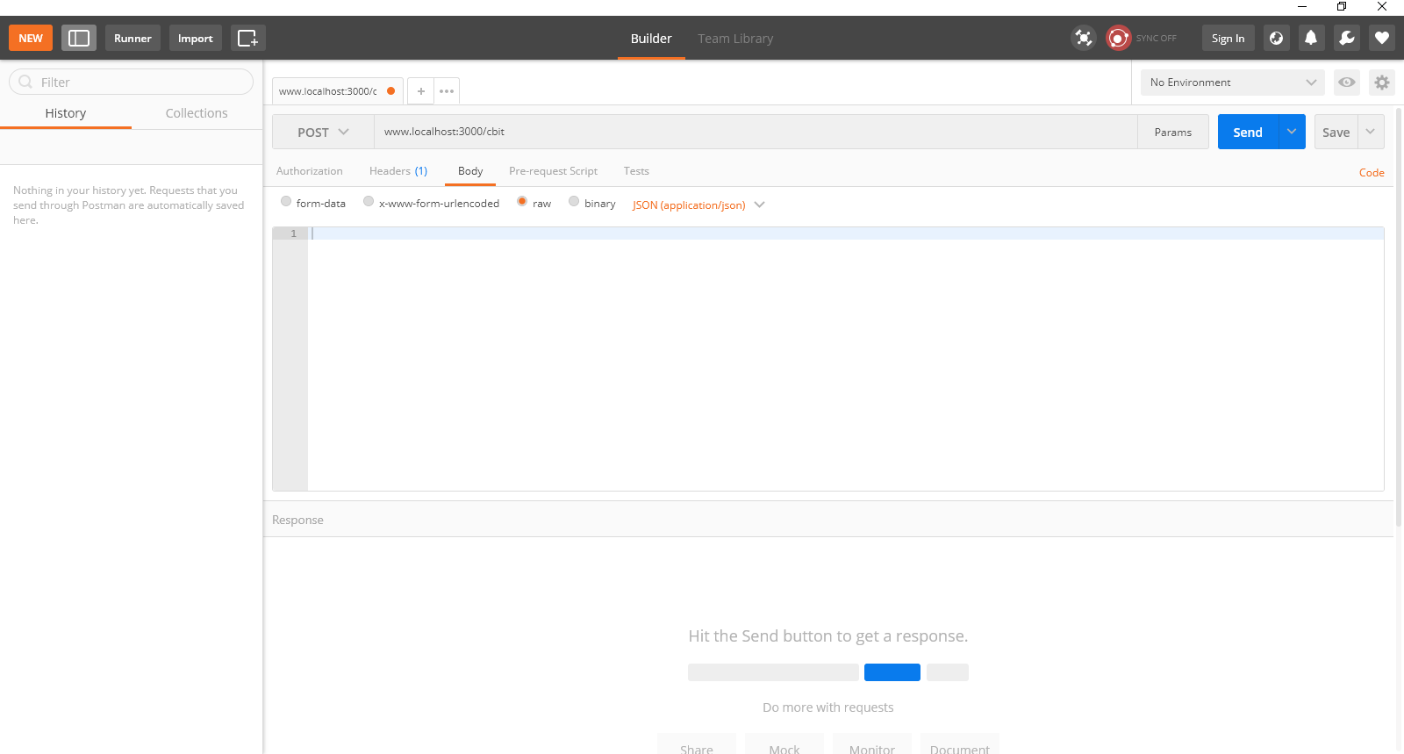
IDE’S Required for FSD-Postman

Slide 20
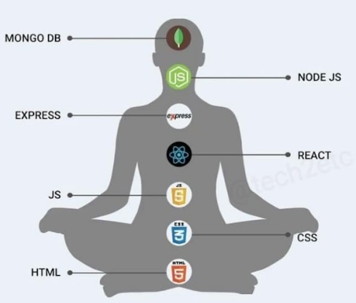

7 Chakras of MERN Stack Developer

Slide 21
MVC pattern
Over the last few years, websites have shifted from simple HTML pages with a bit of CSS to incredibly complex applications with thousands of developers working on them at the same time.
To work with these complex web applications developers, use different design patterns to lay out their projects, to make the code less complex and easier to work with.
The most popular of these patterns is MVC also known as Model View Controller.

Slide 22
MVC pattern
The Model-View-Controller (MVC) framework is an architectural/design pattern that separates an application into three main logical components Model, View, and Controller.
Each architectural component is built to handle specific development aspects of an application.
It isolates the business logic and presentation layer from each other.
It was traditionally used for desktop graphical user interfaces (GUIs).
MVC is one of the most frequently used industry-standard web development frameworks to create scalable and extensible projects. It is also used for designing mobile apps.
MVC was created by Trygve Reenskaug.
The main goal of this design pattern was to solve the problem of users controlling a large and complex data set by splitting a large application into specific sections that all have their own purpose.

Slide 23
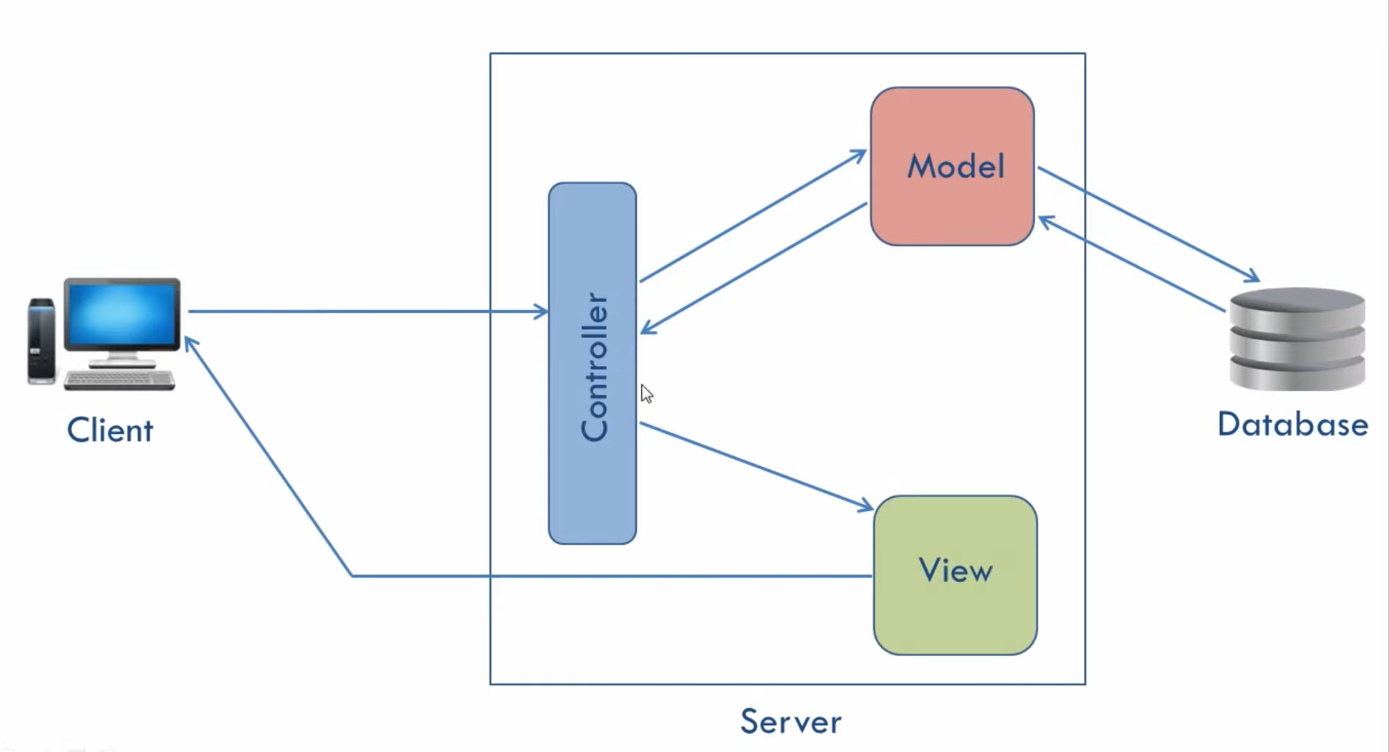
MVC

Slide 24
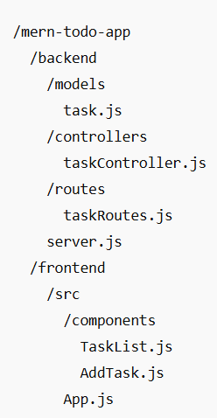
Example structure

Slide 25
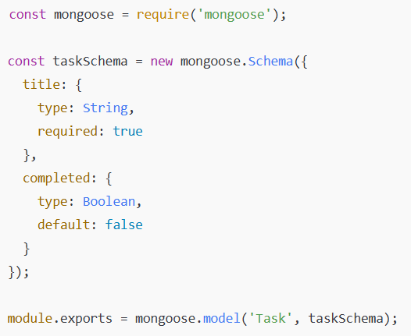
Model (M in MVC)
Create a Mongoose model to represent a Task.
backend/models/task.js

Slide 26
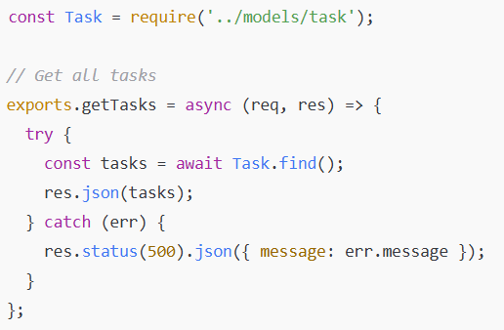
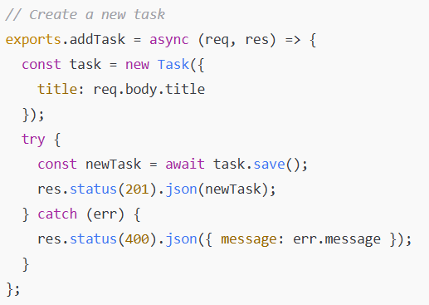
Controller (C in MVC)
Define the logic for handling requests.
backend/controllers/taskController.js

Slide 27
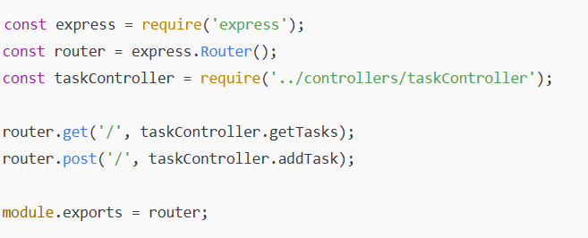
Routes
Wire controller functions to HTTP endpoints.
backend/routes/taskRoutes.js

Slide 28
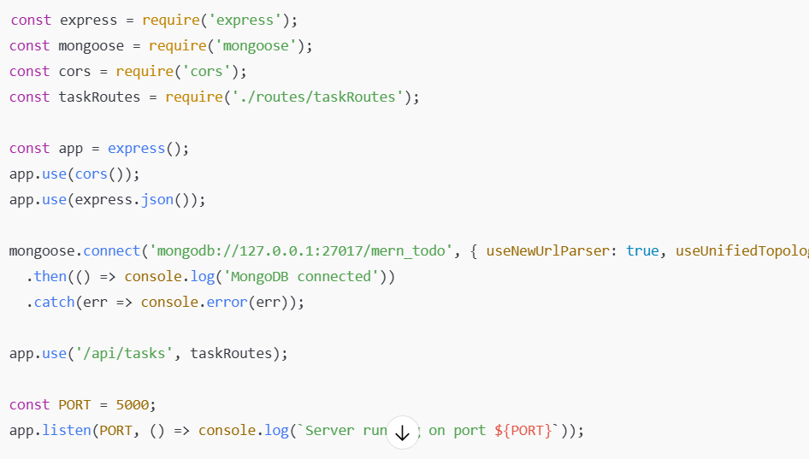
server.js (Express app):
Basic setup to use routes and connect to MongoDB.
backend/server.js

Slide 29
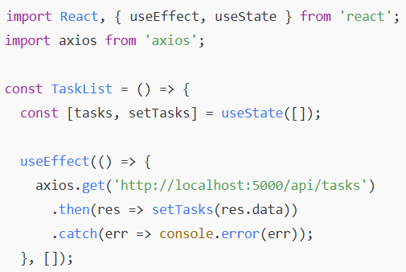
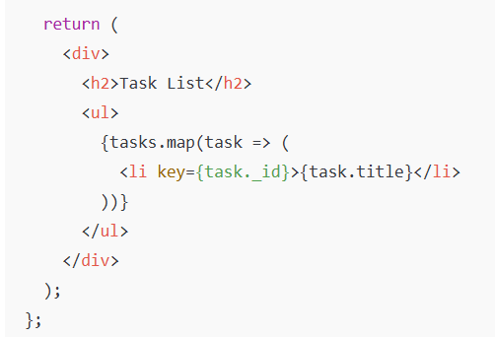
View (V in MVC):
In MERN, the frontend (React) is the View.
frontend/src/components/TaskList.js

Slide 30
Overall Conclusion
Model handles data & schema (MongoDB/Mongoose)
Controller handles business logic (Node.js / Express)
View is the React frontend

Slide 31
Introduction: Web Fundamentals
U.S. Department of Defense(DoD) interested in developing a new large-scale computer network in the 1960’s, which led to ARPAnet (Advanced Research Projects Agency net).
Later in 1970’s and 1980’s BITNET(Because It’s Time Network) and CSNET(Computer Science Network) were developed for servicing the institutions of the Universities.
In 1986 NSFnet (National Science Foundation) was created and replaced ARPAnet for non-military uses.
By 1992, a wide variety of organizations had established nodes on this network and had connected more than 1 million computers around the world.
In 1995 a small part of NSFnet returned to being a research network and the rest became as Internet.

Slide 32
What The Internet Is?
The internet is a huge collection of computers connected in a communication network.
Transmission Control Protocol/Internet Protocol (TCP/IP), became the standard for computer network connections in 1982.
It can be used directly to allow a program on one computer to communicate with a program on another computer via the Internet.
Rather than connecting every computer on the Internet directly to every other computer on the Internet, normally the individual computers in an organization are connected to each other in a local network. (LAN)
One node on this local network is physically connected to the Internet. So, the Internet is actually a network of networks rather than a network of computers.

Slide 33
Internet-Based Services
Email − A fast, easy, and inexpensive way to communicate with other Internet users around the world.
Telnet − Allows a user to log into a remote computer as though it were a local system.
FTP − Allows a user to transfer virtually every kind of file that can be stored on a computer from one Internet-connected computer to another.
UseNet news − A distributed bulletin board that offers a combination news and discussion service on thousands of topics.
World Wide Web (WWW) − A hypertext interface to Internet information resources

Slide 34
Internet Protocol Address
Internet nodes are identified by numeric addresses.
The Internet Protocol (IP) address of a machine connected to the Internet is a unique 32-bit number.
IP addresses usually are written (and thought of) as four 8-bit numbers, separated by periods.
The four parts are separately used by Internet-routing computers to decide where a message must go next to get to its destination.

Slide 35
Internet Protocol Address
Class | Address Range | Supports
Class A | 0.0.0.0 to 127.255.255.254 | Supports 16 million hosts on each of 127 networks.
Class B | 128.1.0.1 to 191.255.255.254 | Supports 65,000 hosts on each of 16,000 networks.
Class C | 192.0.1.1 to 223.255.254.254 | Supports 254 hosts on each of 2 million networks.
Class D | 224.0.0.0 to 239.255.255.255 | Reserved for Multicast Groups.
Class E | 240.0.0.0 to 254.255.255.254 | Reserved for future use, or Research and Development Purposes.

Slide 36
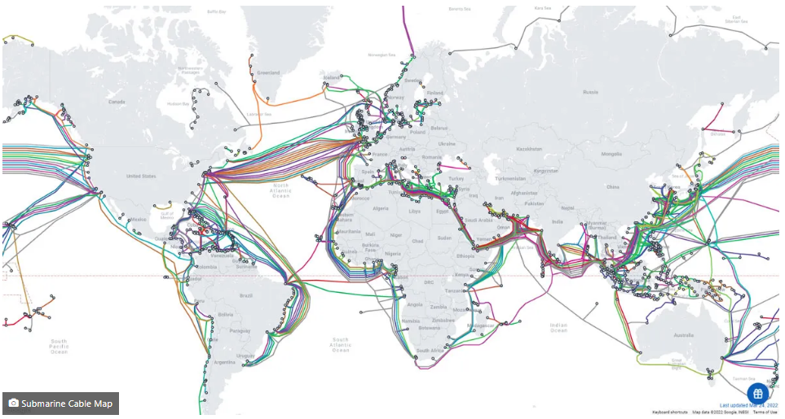
Submarine Cable World Map

Slide 37
Domain Names
Because people have difficulty dealing with and remembering numbers, machines on the Internet also have textual names.
https://www.cbit.ac.in/department-of-information-technology/
Protocol Subdomains Domain Name Top Level Domain File Path
The host name along with the domain names are together called a fully qualified domain name.
These domain names are converted into IP addresses by Domain Name System(DNS)

Slide 38
Domain Name System (DNS)
IP addresses are the addresses used internally by the Internet, But FQDN which is given by a browser user, must be converted to an IP address before the message can be transmitted over the Internet to the destination.
These conversions are done by software systems called name servers, which implement the Domain Name System (DNS).
Name servers serve a collection of machines on the Internet and are operated by organizations that are responsible for the part of the Internet to which those machines are connected.
All document requests from browsers are routed to the nearest name server.
If the name server can convert the fully qualified domain name to an IP address, it does so.
If it cannot, the name server sends the fully qualified domain name to another name server for conversion.
Like IP addresses, fully qualified domain names must be unique.

Slide 39
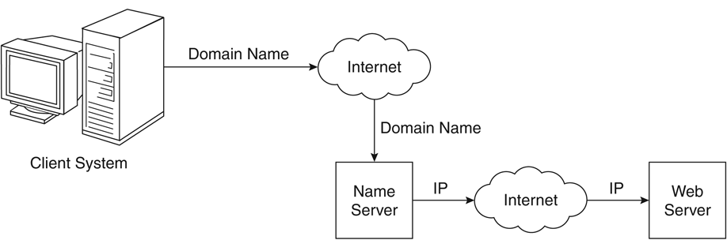
Domain Name Conversion

Slide 40
World Wide Web
In 1989, a small group of people led by Tim Berners-Lee at CERN (Conseil Européen pour la Recherche Nucléaire, or European Organization for Particle Physics),proposed a new protocol for the Internet, as well as a system of document access to use it.
The intent of this new system, which the group named the World Wide Web, was to allow scientists around the world to use the Internet to exchange documents describing their work.

Slide 41
Web or Internet?
The Internet is a collection of computers and other devices connected by equipment that allows them to communicate with each other.
The World Wide Web -- also known as the web, WWW or W3 -- refers to all the public websites or pages that users can access on their local computers and other devices through the internet.

Slide 42
Web Browser and Web Server
A browser is a client on the Web because it initiates the communication with a server, which waits for a request from the client.
Web servers are programs that provide documents to requesting browsers.
Servers are slave programs: They act only when requests are made to them by browsers running on other computers on the Internet.
The most commonly used Web servers are Apache, which has been implemented for a variety of computer platforms, and Microsoft’s Internet Information Server(IIS), which runs under Windows operating systems.

Slide 43
Web Server Operation
Web browsers initiate network communications with servers by sending them URLs
A URL can specify one of two different things:
The address of a data file stored on the server that is to be sent to the client. or
A program stored on the server that the client wants executed, with the output of the program returned to the client.
All the communications between a Web client and a Web server use the standard Web protocol, Hypertext Transfer Protocol (HTTP).

Slide 44
Web Server Operation
The primary task of a Web server is to monitor a communications port on its host machine, accept HTTP commands through that port, and perform the operations specified by the commands.
All HTTP commands include a URL, which includes the specification of a host server machine.
When the URL is received, it is translated into either a file name (in which case the file is returned to the requesting client) or a program name (in which case the program is run and its output is sent to the requesting client).

Slide 45
Uniform Resource Locators
Uniform (or universal) resource locators (URLs) are used to identify documents (resources) on the Internet.
scheme:object-address
In the case of HTTP, the form of the object address of a URL is as follows:
//fully-qualified-domain-name/path-to-document
When file is the protocol, the fully qualified domain name is omitted, making the form of such URLs as follows:
file://path-to-document

Slide 46
Hyper Text Transfer Protocol(HTTP)
All Web communications transactions use the same protocol:
Hypertext Transfer Protocol (HTTP) formally defined as RFC 2616
HTTP consists of two phases:
Request and Response.
Each HTTP communication (request or response) between a browser and a Web server consists of two parts:
Header and a Body.
The header contains information about the communication; the body contains the data of the communication if there is any.

Slide 47
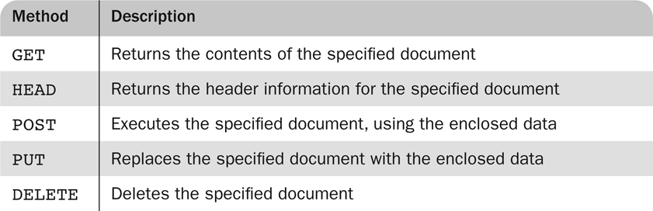
HTTP Request methods
There are four categories of header fields:
General: For general information, such as the date.
Request: Included in request headers.
Response: For response headers.
Entity: Used in both request and response headers.

Slide 48
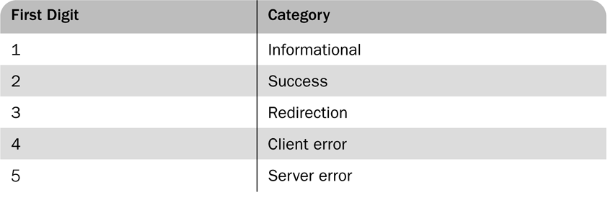
The Response Phase
The general form of an HTTP response is as follows:
Status line
Response header fields
Blank line
Response body
The status line includes the HTTP version used, a three-digit status code for the response, and a short textual explanation of the status code.
HTTP/1.1 200 OK
The status codes begin with 1, 2, 3, 4, or 5.

